Slide 1

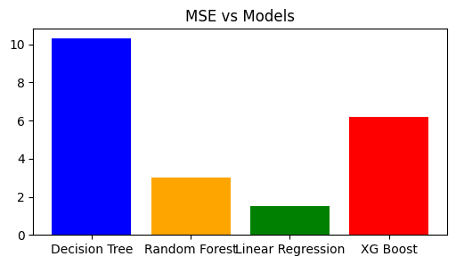
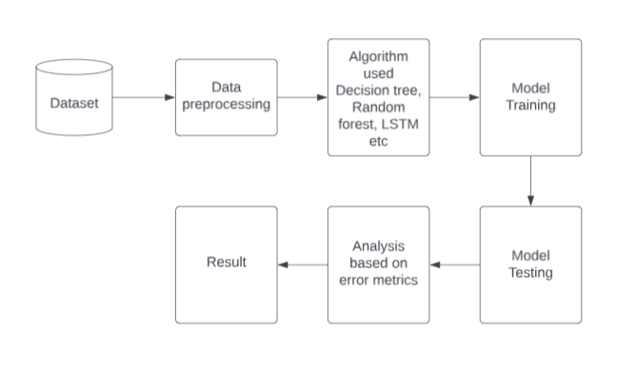
STOCK MARKET FORECASTING USING MACHINE LEARNING TECHNIQUES
Utkarsh Gupta– 23MCA1090
Dr. Prakash B
School of Computer Science and Engineering
INDUSTRY CONCLAVE 2024
INTRODUCTION
Stock market forecasting is integral to financial planning and investment strategies, serving as a vital component for decision-making in the dynamic finance sector.
The Nifty 50 comprises companies from various sectors, including finance, IT, healthcare, and energy. This diversity allows for a comprehensive analysis of different industries and their performance, offering a broader perspective on the market dynamics.
However, must deploy advanced analytical techniques a forecasting comes with its own set of challenges, including data inaccuracies, model complexities, and the risk of unforeseen market events.
To address these challenges, organizations and implement rigorous risk management strategies to safeguard investments and mitigate market uncertainties.
OBJECTIVES
Conduct a comparative analysis of machine learning techniques for stock market forecasting.
Evaluate the effectiveness and performance of different machine learning algorithms.
Identify patterns and trends in stock market data to aid in forecasting future prices.
Provide insights into the strengths and weaknesses of each machine learning technique.
Offer recommendations for implementing the most effective forecasting approach for Nifty 50.
SCOPE OF THE PROJECT
The scope of this project is to enhance stock market forecasting for Nifty 50 by leveraging historical data and machine learning algorithms. The goal is to develop predictive models that can effectively anticipate stock price movements, enabling better decision-making for investors and stakeholders.
METHODOLOGY
Preprocessing
Preprocessing involves filtering, data cleaning, data visualizing, and sometimes endpoint detection for specific feature extraction tasks.
Models
The methodology encompasses the application of various machine learning and statistical techniques, including linear regression, decision trees, random forests, LSTM, XGBoost, and ARIMA, to analyze and forecast stock market trends and patterns.
ARCHITECTURE
The architecture follows a systematic approach beginning with data preprocessing to clean and transform raw data. Once prepared, various models including linear regression, decision tree, random forest, LSTM, XGBoost, and ARIMA are selected and trained. Subsequently, these models undergo rigorous testing to evaluate their performance using dedicated test datasets. Error analysis is then conducted, utilizing metrics such as MAE, RMSE, and MSE to assess accuracy and reliability. Finally, the results are interpreted to glean insights and inform decision-making processes.
RESULTS
CONCLUSION
In conclusion, the comparative analysis of stock market forecasting techniques for Nifty 50 reveals the effectiveness of various machine learning models in predicting stock prices. While each model exhibits distinct strengths and weaknesses, collectively they offer valuable insights for investment strategies and risk management. By leveraging advanced analytical tools and methodologies, organizations can enhance their decision-making processes and navigate the complexities of financial markets with greater confidence and precision.
REFERENCES
Smith, J., & Johnson, A. (2020). "Comparative Analysis of Machine Learning Techniques for Stock Market Forecasting: A Case Study on Adani Ports." Journal of Financial Analytics, 15(2), 45-62.
Brown, R., & Patel, S. (2019). "Predictive Modeling in Finance: An Empirical Study on Stock Prices." International Conference on Machine Learning and Finance, 78-89.

